Slide 1
Capstone Project: FuelStaff
Janine Soo Thow

Slide 2
BACKGROUND
Hospital staff work long stressful hours and often don’t have the time or convenience to prepare their own food and therefore are more likely to adopt unhealthy food habits. Whether having a healthy food application for hospital staff that is responsive and easy to use will be able to help employees perform better at work, which in turn will improve patient care and outcomes, and improve the day-to-day operations.
Why is this problem valuable to address?
Improved overall health among hospital staff means improved focus, productivity, resilience, and performance which can positively impact patient care and outcomes.
Hospitals can reduce healthcare costs associated with poor nutrition.
What is the current state (e.g. unsatisfied users, lost revenue)?
Unhappy and unhealthy healthcare workers because of short break times. Queues at the hospital cafeteria are long, resulting in healthcare workers going to other places nearby and choosing other food options that may or may not be healthy for them, leading to lost revenue for the hospital.

Slide 3
StaffFuel
StaffFuel is a food application for hospitals that offers healthy food options for hospital staff and eliminates the need for its employees to wait in line. As a nurse, I find that with the short break times and long queues of people waiting to order food at the cafeteria can lead to frustration, going to other places to buy unhealthy food options, and having shorter break times.
This app is designed to encourage hospital staff to make nutritious food choices, leading to improved overall health, enhanced performance and improved focus and productivity in the work place, which can in turn, positively impact patient care and outcomes. Because hospital staff also work long stressful hours, it may be challenging to maintain a healthy diet, and so a healthy food app can assist them in making informed choices and reduce their risk of cardiovascular diseases, such as diabetes and heart disease. StaffFuel will only collect essential data from hospital staff needed to run the service, such as employee ID number, full name, email and payment.

Slide 4
OBJECTIVES
Promote healthy eating: StaffFuel is designed for staff. We believe that providing healthy food options for hospital staff will have a positive impact on their physical, emotional and mental performance as well as patient care and outcomes. In order to retain a healthy workforce, having healthy food options is where it starts. We cannot forget about our wonderful staff who do a good job looking after our patients, so to continue this we must look after them too.
Foster a healthy work culture: StaffFuel will foster a sense of community engagement. Promoting wellness challenges, sharing success stories and facilitating social interactions can lead to a supportive environment where staff motivate and inspire each other to lose weight, make healthier choices and create healthier behaviours.
Increase awareness and education about the importance of healthy eating: It is essential staff understand the importance of healthy eating and how it can impact on health and job performance. The app will provide educational conetent and tips on nutrition, helping staff members make informed choices and have a better understanding of healthy eating and why it is important.
Promote convenience and accessibility: Because hospital staff work long hours, it is important healthy food options are easily accessible. It will include features such as meal pre-ordering and a menu with healthy food options.

Slide 5
STAKEHOLDERS
Hospital employees
Businesses utilising the food application
EXPECTATIONS
Easy to use application, easy to learn and use, attractive UI aesthetics, customers should be able to login in, choose from a range of healthy food options and order and make a payment easily without any issues

Slide 6
What customers want in this software
Customer Login and registration account
Menu
Search for meals
Add orders to shopping cart
Successfully pay for their order
Support
Educational content
Upcoming events

Slide 7
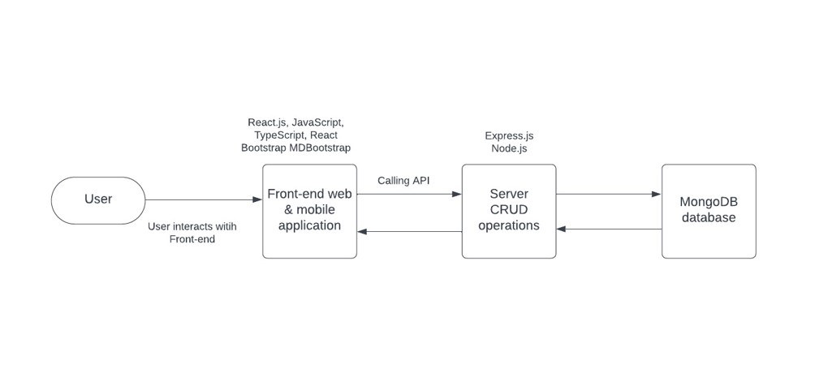
ARCHITECTURE DIAGRAM

Slide 8
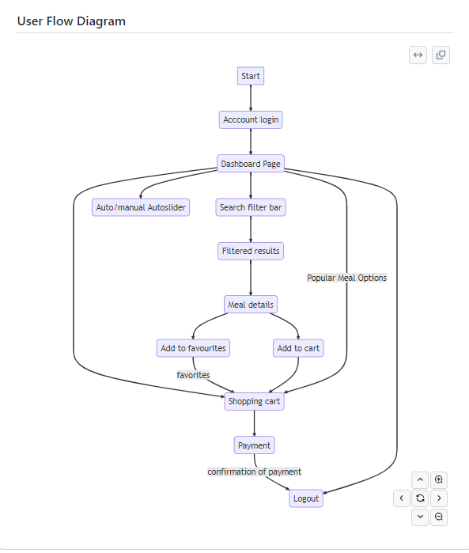

Slide 9
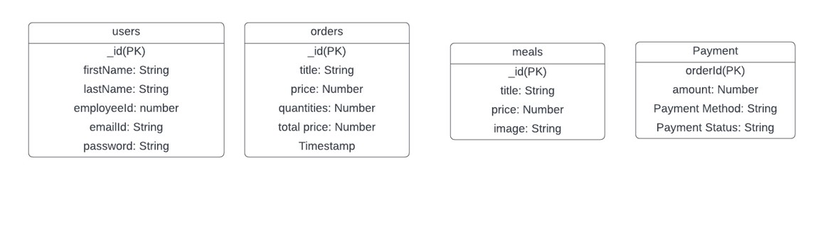

Slide 10
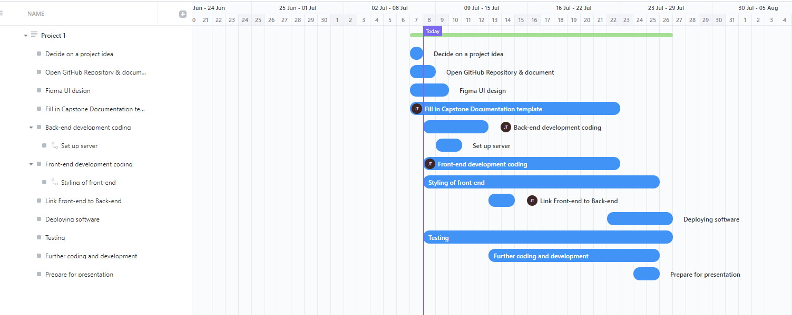
GANTT DIAGRAM

Slide 11
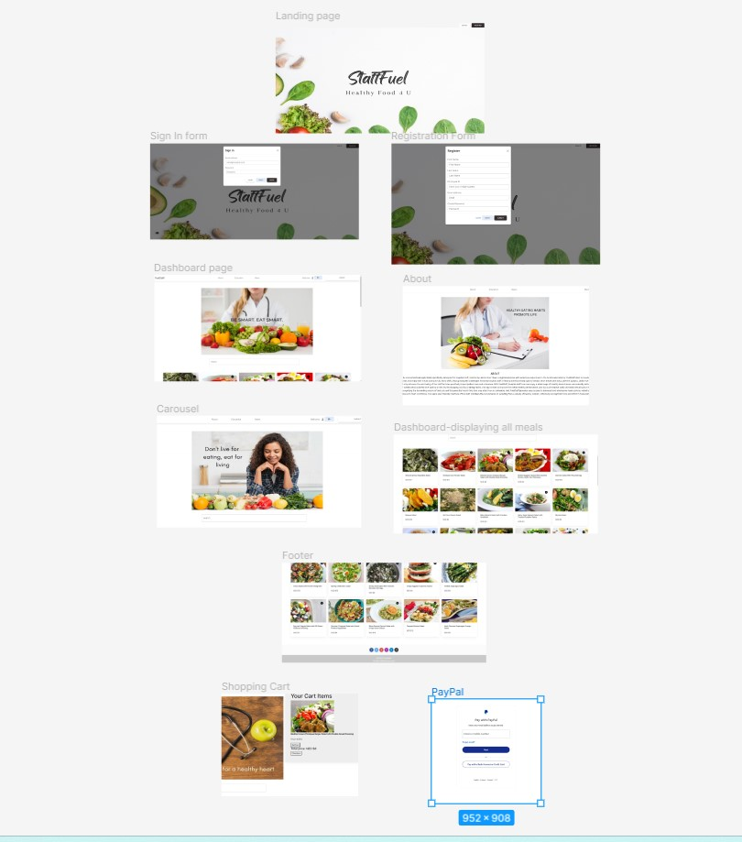
WIREFRAME DESIGN - FIGMA
https://www.figma.com/file/eXC3KGwNWiIYEjw46u0ZNE/Capstone-IOD-project?type=design&node-id=0%3A1&mode=design&t=DGerSc32avtH2dRu-1

Slide 12
OUT OF SCOPE
What features are considered out of scope?
Food preparation tracking system
Fallback payment system option
Rewards and loyalty programs
Offering multi-language support
Meal reviews and ratings
Chatbot support for customer support
Integration with social media apps
Multiple payment gateways

Slide 13
NON-FUNCTIONAL REQUIREMENTS
What are the key security requirements? (e.g. login, storage of personal details, inactivity timeout, data encryption)
Password encryption, user timeout to prevent unauthorized requirements, storage of customer details in a database backen.
How many transactions should be enabled at peak time?
The online food application should be able to manage concurrent requests and transactions at peak times.
How easy to use does the software need to be?
It needs to be relatively easy to use for all users. The interface must be user friendly and the navigation must be easy for users of all backgrounds with variable levels of tech experience, to use.
How quickly should the application respond to user requests?
To provide a seamless and optimal shopping experience, the software application should respond to user requests as quickly as possible. The application response time should be less than 5 seconds.
How reliable must the application be? (e.g. mean time between failures)
The software must be 100% reliable with close to 100% uptime. User authentication must be reliable when users sign in with the login form or register with the registration form. This is because the users personal information are being used.

Slide 14
TESTING
Testing of the software was abundant throughout the software development process. Individual components were tested to make sure they were working effectively. This involved using a combination of tools to verify components were working correctly, such as Chrome developer tools, VS code terminal to check for error messages and using the database to make sure data showed up in the database.

Slide 15
DEPLOYMENT OF SOFTWARE CONSIDERATIONS
Security
Backup and recovery
Monitoring server health and app performance
Carrying out comprehensive testing methods
Developing user guides for customers on how to use the app effectively
Assistance for any issues
Feedback from customers

Slide 16
References
GITHUB
https://github.com/JanineSooThow/Capstone-project
API
https://rapidapi.com/spoonacular/api/recipe-food-nutrition/
DESIGN
https://mdbootstrap.com/

